Slide 1

Introduction to Variables & Data types in java

Slide 2
Objective
Explain variables and their purpose
State the syntax of variable declaration
Explain the rules and conventions for naming variables
Explain data types
Describe primitive and reference data types
Describe escape sequence
Describe format specifiers
Identify and explain different type of operators
Explain the concept of casting
Explain implicit and explicit conversion

Slide 3
Introduction
The core of any programming language is the way it stores and manipulates the data.
The Java programming language can work with different types of data, such as number, character, Boolean, and so on.
To work with these types of data, Java programming language supports the concept of variables.
A variable is like a container in the memory that holds the data used by the Java program.
A variable is associated with a data type that defines the type of data that will be stored in the variable.
Java is a strongly-typed language which means that any variable or an object created from a class must belong to its type and should store the same type of data.
The compiler checks all expressions variables and parameters to ensure that they are compatible with their data types.

Slide 4
Variables 1-2
Following figure depicts a variable that acts as a container and holds the data in it:
Variables
are used in a Java program to store data that changes during the execution of the program.
are the basic units of storage in a Java program.
can be declared to store values, such as names, addresses, and salary details.
must be declared before they can be used in the program.
A variable declaration begins with data type and is followed by variable name and a semicolon.
A variable is a location in the computer’s memory which stores the data that is used in a Java program.

Slide 5
Variables 2-2
The data type can be a primitive data type or a class.
The syntax to declare a variable in a Java program is as follows:
where,
datatype: Is a valid data type in Java.
Variable Name: Is a valid variable name.
Following code snippet demonstrates how to declare variables in a Java program:
In the code, the statements declare an integer variable named rollNumber, and a character variable called gender.
These variables will hold the type of data specified for each of them.
Syntax
datatype variable Name;
. . .
int rollNumber;
char gender;
. . .

Slide 6
Rules for Naming Variables 1-2
The convention, however, is to always begin your variable names with a letter, not ‘$’ or ‘_’.
For example, the variable names number and Number refer to two different variables.
Variable names may consist of Unicode letters and digits, underscore (_), and dollar sign ($).
A variable’s name must begin with a letter, the dollar sign ($), or the underscore character (_).
Variable names must not be a keyword or reserved word in Java.
Variable names in Java are case-sensitive.
If a variable name comprises a single word, the name should be in lowercase.
If the variable name consists of more than one word, the first letter of each subsequent word should be capitalized.

Slide 7
Assigning Value to a Variable 1-2
Values can be assigned to variables by using the assignment operator (=).
There are two ways to assign value to variables. These are as follows:
Following code snippet demonstrates the initialization of variables at the time of declaration:
In the code, variable rollNumber is an integer variable, so it has been initialized with a numeric value 101.
Similarly, variable gender is a character variable and is initialized with a character ‘M’.
The values assigned to the variables are called as literals.
At the time of declaring a variable
...
int rollNumber = 101;
char gender = ‘M’;
...
Literals are constant values assigned to variables directly in the code without any computation.

Slide 8
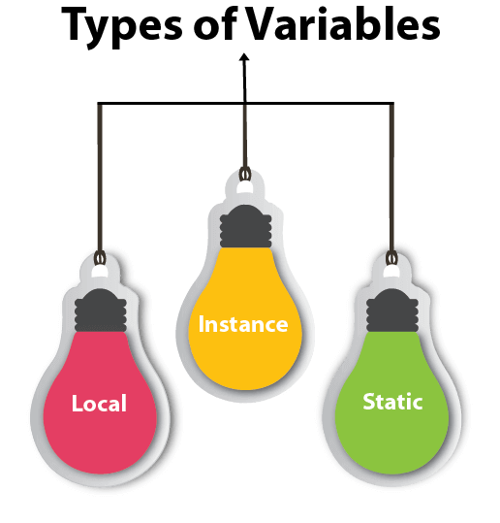
Different Types of Variables
Java programming language allows you to define different kind of variables that are categorized as follows:
The variables declared within the class can be instance variables or static variables.

Slide 9
Local Variable
A variable declared inside the body of the method is called local variable. You can use this variable only within that method and the other methods in the class aren't even aware that the variable exists.
A local variable cannot be defined with "static" keyword.
The lifetime of these variables depends on the execution of methods.
This means memory is allocated for the variables when the method is invoked and destroyed when the method returns.
After the variables are destroyed, they are no longer in existence.
The parameter variables are also treated as local variables which means their existence is till the method execution is completed.
Local variables

Slide 10
Instance variables
A variable declared inside the class but outside the body of the method, is called instance variable. It is not declared as static.
It is called instance variable because its value is instance specific and is not shared among instances.
class InstanceVarible{
int data=50;//instance variable
public static void main(String args[]){
InstanceVariable instanceObject=new InstanceVarible();
instanceObject.data ;
System.out.println( nstanceObject.data );
}
}

Slide 11
Local Variable Example
Following figure shows the scope and lifetime of variables x and y defined within the Java program:

Slide 12
Static variable
Static variables
A variable which is declared as static is called static variable. It cannot be local. You can create a single copy of static variable and share among all the instances of the class. Memory allocation for static variable happens only once when the class is loaded in the memory.
Static variables are shared between the objects and exists for the lifetime of a class.

Slide 13
Data Types
Data types are divided into two groups:
Primitive data types - includes byte, short, int, long, float, double, Boolean and char
Non-primitive data types - such as String, Arrays and Classes.
Data Type Size Description
byte 1 byte Stores whole numbers from -128 to 127
short 2 bytes Stores whole numbers from -32,768 to 32,767
int 4 bytes Stores whole numbers from -2,147,483,648 to 2,147,483,647
long 8 bytes Stores whole numbers from -9,223,372,036,854,775,808 to 9,223,372,036,854,775,807
float 4 bytes Stores fractional numbers. Sufficient for storing 6 to 7 decimal digits
double 8 bytes Stores fractional numbers. Sufficient for storing 15 decimal digits
Boolean 1 bit Stores true or false values
char 2 bytes Stores a single character/letter or ASCII values

